Slide 1

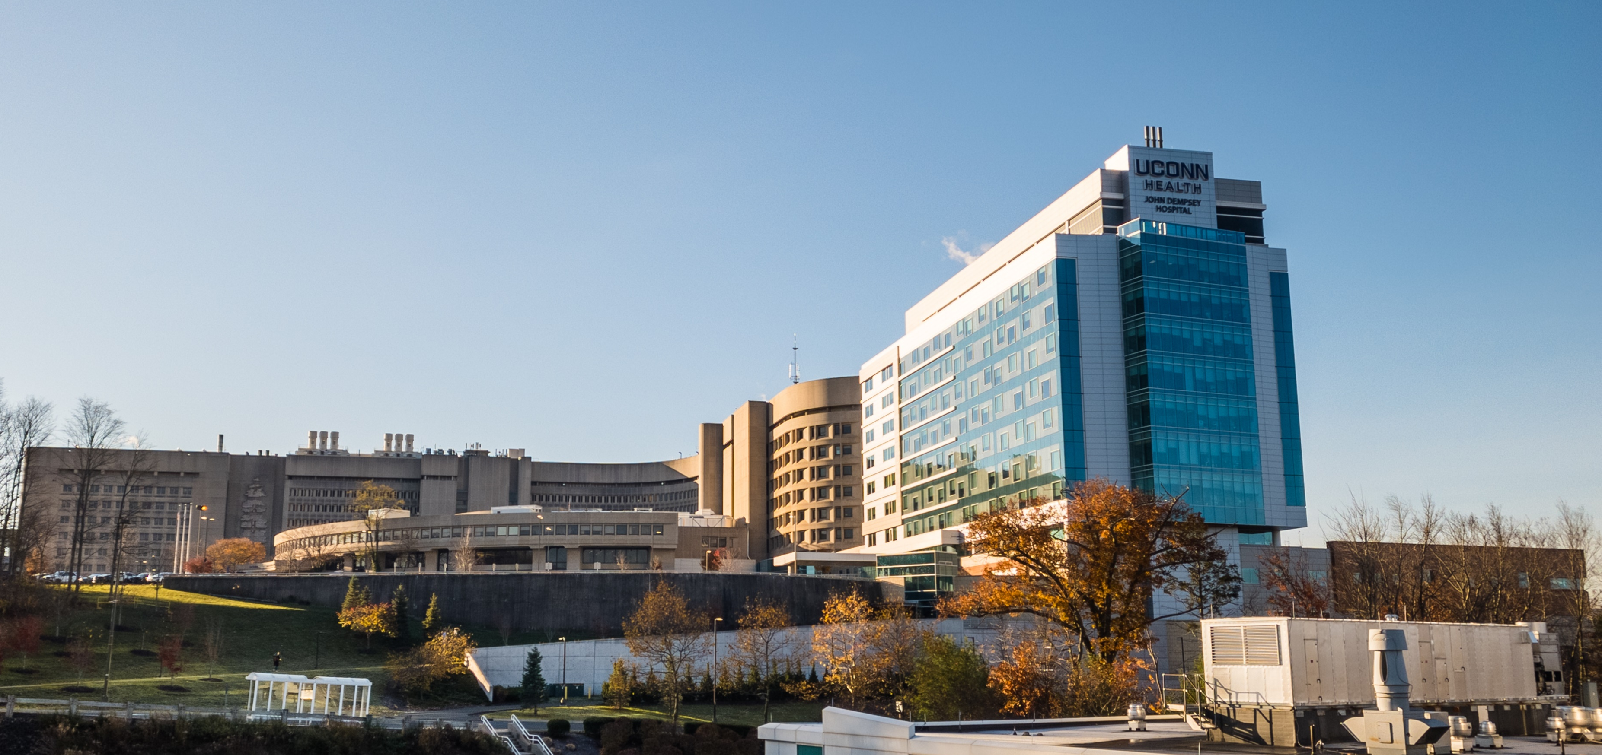

FY22/23 Financial Update
for UConn & UConn Health
Briefing for the Financial Affairs Committee of the Board of Trustees
October 21, 2022

Slide 2
UConn: FY22 Year-End Results
The University ended FY22 in balance
(1)
Highlights
FY22 Year-End Actuals
Budget
Actuals
Variance
Percent
1) State Appropriations – Favorable, reflecting additional funds for block grant
(unaudited)
Variance
and non-block grant employee retro SEBAC CBI contracts settled in Spring 2022
State Appropriations
$ 408.5
$ 459.8
$ 51.3
12.5%
2) Tuition – Unfavorable, due to graduate programs (waiver offsets) and
Tuition
472.6
468.3
(4.3)
-0.9%
international students studying in China, offset in other revenues
Course/Mandatory Fees
158.6
153.0
(5.6)
-3.5%
3) Course Fees – Unfavorable, due to a decline in professional program Fall
(2)
307.0
331.2
24.3
7.9%
enrollment and decreased intersession revenue
Grants & Contracts
4) Grants & Contracts – Favorable, due to additional State ARPA funding,
Auxiliary Revenue
185.5
187.9
2.4
1.3%
financial aid pass-throughs, and timing of Federal COVID relief funding
(3)
77.0
83.1
6.1
7.9%
Other Revenues
5) Auxiliary Revenue – Favorable, due to higher than budgeted housing counts
Total Revenues
$
1,609.2
$
1,683.3
$
74.1
4.6%
and Athletics revenues
6) Other Revenue – Favorable, due to higher-than-expected Foundation
Salary/Benefits
$ 968.3
$ 1,027.3
$ 59.0
6.1%
revenues, primarily in Athletics
Financial Aid
260.8
269.1
8.3
3.2%
7) Salaries/Benefits – Unfavorable, due to retroactive FY22 contractual
(4)
380.1
387.0
6.9
1.8%
bargaining increases and one-time payments
Other Expenses
Total Expense
$
1,609.2
$
1,683.3
$
74.1
4.6%
8) Financial Aid – Unfavorable, due to increased State and Federal pass-
throughs (offset in income)
9) Other Expenses – Unfavorable, due to the additional reimbursement to plant
Net Income/(Loss)
$
-
$
-
$
-
funds caused by the timing of COVID relief funding
(1) Includes Operating and Research funds
(2) Includes financial aid
(3) Includes Foundation, investments, gifts and self-supporting revenue
(4) Includes equipment, utilities and transfers/debt service and other operating expenses
Notes:
FY22
Detail on what we budgeted for grad waivers vs actual and what is the amount for China students
Grad Waiver budget $60.9M/actual $64.7M = -$3.8M
East China = -$4.3
Carryforward/Other makes up the offset
Other revenues increase: half of total is due to greater drawdown of Foundation funds for athletics

Slide 3
UConn: FY23 Budget
The University is projecting a balanced budget in FY23
FY23 Budget
(1)
Highlights
FY22 Actuals
FY23 Budget
Change
Percent
The FY23 budget includes continued cost savings initiatives as well as the
Change
following changes from FY22:
$ 459.8
$ 445.9
$ (13.9)
-3.0%
1
)
State Appropriations
–
Received additional one
-
time support for FY
State Appropriations
23
CBI for
Tuition
468.3
505.2
36.9
7.9%
block grant employees, but non-block grant CBI support ($33.2M) was provided
Course/Mandatory Fees
153.0
160.1
7.1
4.6%
from federal funds classified in the Grants & Contracts line instead of State
(2)
331.2
322.3
(9.0)
-2.7%
Appropriation
Grants & Contracts
2
)
Tuition
–
Reflects increases in rate and first
-
Auxiliary Revenue
187.9
201.9
14.0
7.4%
year enrollment as well as East
(3)
China Normal University students returning to Storrs campus (offset in other
Other Revenues
83.1
73.4
(9.7)
-11.7%
income)
3
)
Course
/
Mandatory Fees
Total Revenues
$
1,683.3
$
1,708.7
$
25.4
1.5%
–
FY
23
includes some professional program rate
increases and increases in GUF, SHaW, IMF, Tech, and Transit fees
Salary/Benefits
$ 1,027.3
$ 1,072.5
$ 45.3
4.4%
4
)
Grants
&
Contracts
–
FY
22
included one
-
time federal funds removed in FY
23
269.1
252.0
(17.1)
-6.4%
5
)
Auxiliary Revenue
–
Reflects increases in on
-
Financial Aid
campus housing and rate
(4)
387.0
384.2
(2.8)
-0.7%
increases in room and board in FY23
Other Expenses
6
)
Other Revenue
Total Expense
$
1,683.3
$
1,708.7
$
25.4
1.5%
–
FY
22
includes revenues from international students
studying at East China Normal University, moved to tuition based in FY23
7
)
Salaries
/
Benefits
–
FY
23
includes a
4
.
5
%
SEBAC CBI plus lump sum payments
,
Net Income/(Loss)
$
-
$
-
$
-
increased fringe rate, and faculty hiring
8
)
Financial Aid
–
FY
22
included one
-
time federal COVID funds removed in FY
(1) Includes Operating and Research funds
23
9
)
Other Expenses
(2) Includes financial aid
–
Modest increases are expected in general operating
(3) Includes Foundation, investments, gifts and self-supporting revenue
activity with less funding transferred to capital/projects
(4) Includes equipment, utilities and transfers/debt service and other operating expenses
Notes:
FY23
Detail for amount of CBI’s vs amount for new hiring
CBI $32.8M – Net 4.5% perm, $1K lump sum (less $2.5k lump in FY22)
Hiring $7.1M – Faculty and Supplemental Utility Plant positions
Other FB adj $5.4M – FB rate change
Total $45.3M

Slide 4
UConn: FY23 Financial Improvement Plan
Through the first quarter of FY23, the University has realized $4.0M in savings and is on track to reach the full $14.5M target
Notes:
More detail on tuition loss
Waiver Variance $5.3
East China Restatement $2.1
Transfer residency mix and melt $8
Change in grants & contracts of $1.5 vs change in fin aid of $4.0
Grants and Contract revenues reflect additional state and federal financial aid passthrough. The difference between growth in G&C revenue and financial aid funds reflects department funding of aid and a small contingency

Slide 5
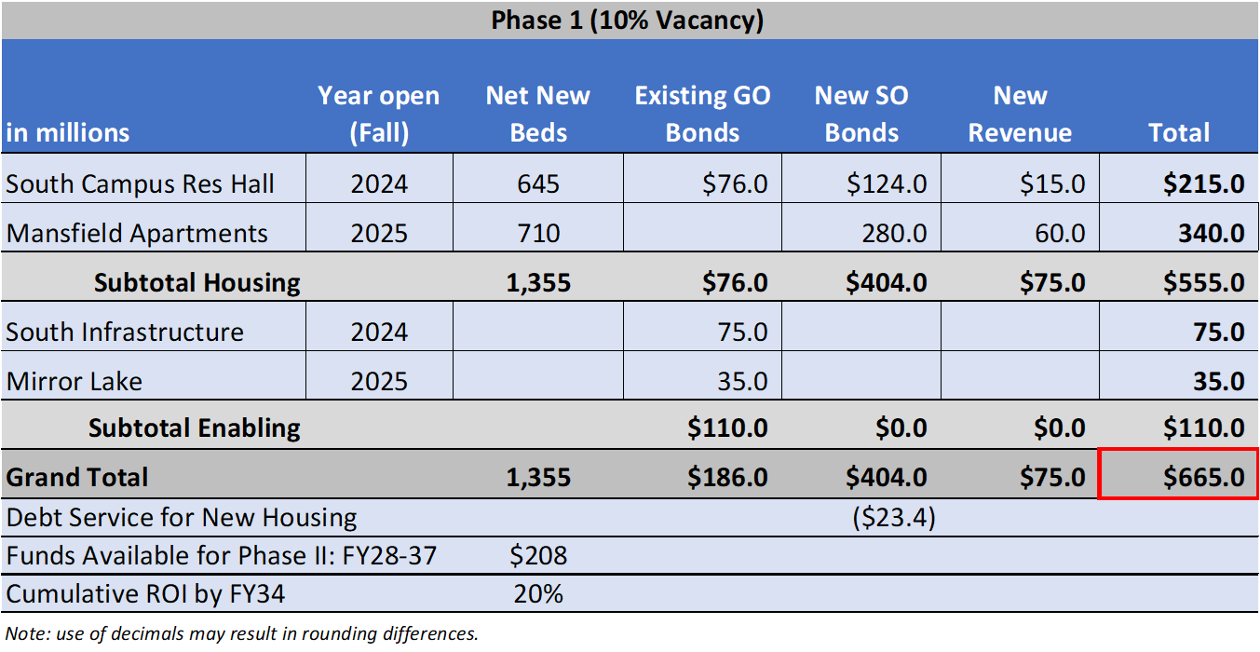
UConn: Housing Renewal Financing Plan
5

Slide 6
UCH: FY22 Year-End Results
UConn Health ended FY22 in balance

Slide 7
UCH: FY23 Budget
UConn Health is projecting a balanced budget in FY23

Slide 8
UCH: FY23 Financial Improvement Plan
Through the first quarter of FY23, UConn Health has realized $0.9M in savings and is on track to reach the full $5.0M target

