Slide 1
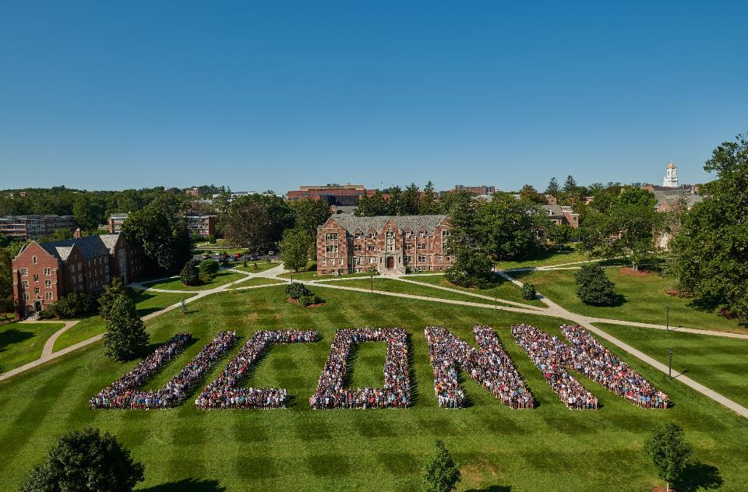

Who We Are
Spring 2022

Slide 2
UConn
Table of Contents | Page
Who We Are: Economic Impact, Applications, Enrollment, Student Success, Cost of Attendance, Financial Aid | 6 – 20
Research & Innovation: Research Grants, Commercialization, and Industry Support | 21 – 33
NextGenCT: Progress, Student Growth | 34 – 39
Operating Budget: Revenue & Expenses, State Support, Fringe Costs, Challenges | 40 – 51
Capital Budget: Challenges, Budget Plan, Bond Status | 52 – 60
Notes:
Alter to match new slides*

Slide 3
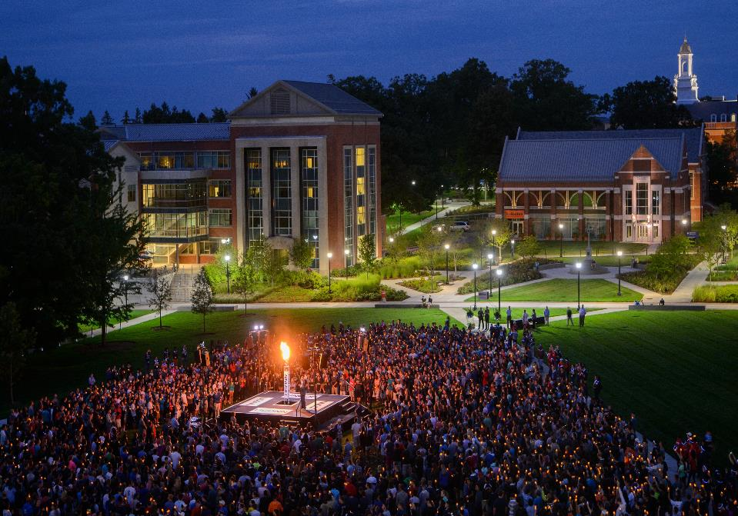

Welcome to UConn
32,000+
students
including UConn Health
276,969
alumni
80+
research centers
5 campuses
plus UConn Law and UConn Health
$5.1 billion
in annual state economic impact
Notes:
DONE 11-5-2021
OIR confirmed student count Fall 2021 all locations including UCH = 32,146
https://uconn.edu/research/ states “…our more than 80 research centers and institutes.”
Updated 10/21

Slide 4


Our Students Today
76%
Connecticut residents
42%
diverse backgrounds
92%
retention rate into sophomore year
4.1 years
average time to complete degree
Notes:
OIR – updated 10/29/2021

Slide 5


146,000
alumni live in Connecticut
62%
Our
Graduates
of recent graduates, who attended high school in CT & who are employed, are working in the state
18%
of graduates who did not attend high school in CT & who are employed, are working in the state
Notes:
CCD –website.
Alumni info is from fact sheet
Jim Lowe/Lee Hameroff
updated 10/21

Slide 6
UConn
Who We Are

Slide 7

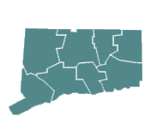

UConn Impact on Connecticut Economy
UConn contributes $5.1 Billion annually to the state’s economy
$276M
State and Local
Tax Revenue
$1,408
Generated for Every
CT Resident
25,130
UConn-supported
Jobs
Note: Economic impacts include direct, indirect, and induced spending effect. FY 2020 data.
Notes:
Updated 10/21

Slide 8
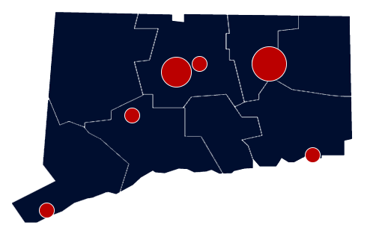
UConn Impact on CT Communities
Of the overall $5.1 billion impact:
  $2.6B Storrs
  $2.2B UConn Health
  $145M Greater Hartford
  $45M Avery Point
  $52M Stamford
  $23M Waterbury
Notes:
Updated 10/21

Slide 9

UConn Graduation Impact
In-state graduates are over 4 times more likely to work in-state after graduating from UConn than out-of-state graduates
UConn graduates earn an average yearly starting salary of $57,750 which is higher than the national average
Top Hiring Employers
Cigna
Collins Aerospace
Deloitte
Electric Boat
Hartford Hospital
Lockheed Martin
PwC
The Hartford
Travelers
Yale New Haven Health
89%
Positive Outcome Rate as of 6 months post-graduation
Notes:
Jim Lowe & Lee
Updated 10/21

Slide 10




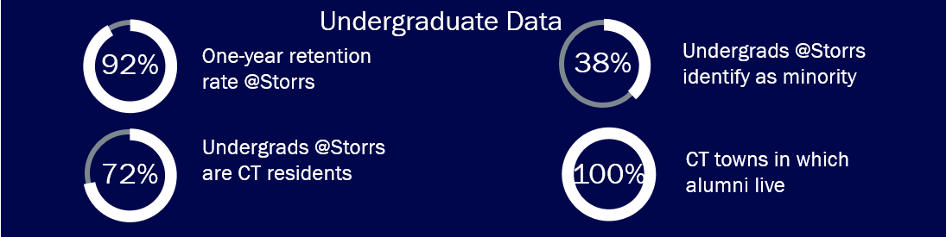
28
23
2
BY THE NUMBERS
Times Higher Ed,
Best Public Universities (US)
US News, Top Public National Universities
GreenMetric, US Sustainability Ranking
Times Higher Ed,
Best Public Universities (US)
First Year Students
48%
First Year domestic students identify as minority
38,929
71%
First Year domestic students are CT residents
Incoming First Year Applications
Undergrad Data
One-year freshman retention rate @Storrs
Undergrads @Storrs identify as minority
Undergrads @Storrs are CT residents
CT towns in which alumni live
Notes:
DONE 11-4-2021
Fall 2021 first year students, all campuses - middle section
Bottom blue portion: one year retention = 92%
Fall 2021 Undergrads at Storrs CT residents = 72% (degree-seeking only)
Fall 2021 Undergrads at Storrs minority = 38% (degree-seeking only)
Waiting on revision updates per GR notes 11/18/21

Slide 11
UConn is in Demand
Demand for UConn education is strong, and quality of First Year Student class is highly competitive
First Year application trends continue to rise to nearly 39,000 for about 5,500 seats in 2021
Applications at all campuses have increased 264% since Fall 1996 and 36% since 2011
Mean SAT* scores of Storrs Campus entering First Year Student for Fall 2021 is 1318
  National Mean SAT is 1060
  CT Mean SAT is 1072
  161 Valedictorians and Salutatorians
*SAT Data: Standardized test average represents students who elected to submit test scores as part of their application materials.
Notes:
OIR/Admissions – updated 10/21

Slide 12
Enrollment Growth
Undergraduate enrollment has increased 46% in the last 25 years
3 of every 4 students are from CT high schools
Residency (All Campuses) | 2001 | 2006 | 2011 | 2016 | 2021
In-State First Year | 74% | 76% | 77% | 75% | 72%
Out-of-State First Year | 26% | 24% | 23% | 25% | 28%
In-State Undergrads | 81% | 80% | 80% | 77% | 76%
Out-of-State Undergrads | 19% | 20% | 20% | 23% | 24%
Notes:
OIR. DONE 11-4-2021

Slide 13
UConn Student Success
UConn is one of the best in the nation at graduating students in 4 years
Average time to degree of 4.1 years ranks 1st among National Public Research Universities
Fall 2015 entering cohort had a 6-year graduation rate (in 2021) of 83%
Data: Storrs Campus
Notes:
OIR – DONE 11-5-2021

Slide 14
UConn Student Success
First Year Student retention rates are among the highest in the nation
Ranks 12th among the National Public Research Universities
Our retention rates are nearly 10% higher than the national average for all First Year and minority First Year Students
Based on national data from the Consortium for Student Retention Data Exchange (CSRDE)
National average
National average
National average
National average
Data: Storrs Campus
Notes:
OIR – DONE 11-5-2021
CSRDE average continuation rate all first year = 84.2%, minority = 82.6% (CSRDE=public and private colleges)

Slide 15
UConn Remains Affordable in 2021-22
UConn provides an excellent education at affordable costs, with in-state rates that are much lower than other regional alternatives
NICHE Best Value Colleges in America ranked UConn 40th out of 700 public colleges
Princeton Review ranked UConn in the top 50 Best Value Public Colleges for their Return-on-Investment (ROI) rating out of 200 schools
 | In-State | Out-of-State
Tuition | $15,030 | $37,698
Mandatory Fees | 3,494 | 3,494
Subtotal | $18,524 | $41,192
Room & Board | 13,258 | 13,258
Direct Cost of Attendance* | $31,782 | $54,450
*Does not include costs for books, supplies, transportation, etc.
Notes:
Kelly/OIR – Lauren
https://www.niche.com/colleges/search/value/?type=public
Updated 10/21

Slide 16
Tuition and Fees vs Competitors
For Connecticut residents, UConn offers the best value compared to leaving the state to attend a peer university
UConn In-State Rate
FY22 Published Rates
Notes:
These are ASQ schools – Admitted Student Questionnaire. This is national survey is conducted by the College Board.
What a Connecticut Resident would pay (Sticker Price) verses UConn's Competitors. Includes mandatory fees, some fees vary by program by institution.
For a Connecticut resident, UConn offers the best value
Updated 10/21

Slide 17
Tuition and Fees vs Competitors
FY22 In-State tuition and fees at competitor public flagship institutions
FY22 Published Rates
Notes:
Updated 10/21

Slide 18
Financial Aid
UConn is doing its part to ensure access and affordability by increasing financial aid support; the Federal relief acts provided $50.4M of relief funding from FY20-FY22 ($10.8M, $11.1M and $28.5M respectively)
University Supported aid has increased 22% over the last 3 years
Approximately 78% of all undergraduates are receiving some form of financial aid
Undergraduate & Graduate Aid ($M) | FY19 | FY20 | FY21 | FY22 Forecast | FY19-FY22 Change
University Supported* | $129.2 | $142.8 | $150.2 | $162.8 | $33.6
State (includes R. Willis Scholarship) | 9.0 | 9.7 | 10.7 | 10.0 | 1.0
Federal (Pell/SEOG) | 35.3 | 46.2 | 51.4 | 68.8 | 33.5
Other** | 14.8 | 12.9 | 17.5 | 19.8 | 5.0
Total Aid | $188.3 | $211.7 | $229.8 | $261.4 | $73.1
*University Supported includes undergraduate and graduate aid funded by tuition, departmental revenue, and work study
**Other funding comes from the private sources such as the Foundation and Endowments
Notes:
Updated 10/21

Slide 19



Spring 2022 COVID-19 Status*
Our work is not done; we still must take precautions and follow testing, social distancing, masking and hygiene protocols
Vaccinations
COVID Testing
Campus Guidelines
Vaccination Status**
96% UConn employees are fully or partially vaccinated
On average 94% of all students on 6 campuses are fully or partially vaccinated
All in-person students on campus are required to be vaccinated or granted an exemption
All employees must be vaccinated or be granted a deferral or medical/religious exemption
Random testing on the Storrs campus to identify cases and isolate them before they spread
Using pooled surveillance screening of both wastewater and saliva samples on the Storrs campus to identify areas of viral concentration
Student social distancing is not required since vaccinations are mandatory; unvaccinated students are requested to maintain 6 ft of space
Masking is not required outside, but is required indoors
COVID Information Center
UConn has launched a COVID-19 Information Center to direct individuals to appropriate resources to address non-emergency questions and concerns
*Excludes UConn Health
**COVID statistics as of 11/3/21
Notes:
Updated 10/21

Slide 20
COVID Federal Relief
UConn has received $176.9M in COVID relief funding to date.
  $85.7M to help offset revenue losses, which helped reduce deficits in FY20,21,22
  $50.4M in student aid
  $40.8M in expense reimbursements

Slide 21
UConn
Research & Innovation
Economic Driver for Connecticut

Slide 22

UConn Research & Innovation:
Economic Driver for CT
2,378
Jobs supported by research
$26M
State and local tax revenue from UConn research
$504M
Economic impact of UConn's research enterprise
UConn’s research operations make real and vital contributions to the State’s economy
Generally, every $1,000 of research expenditure results in $800 in value added to the state economy
Notes:
updated 10/21

Slide 23
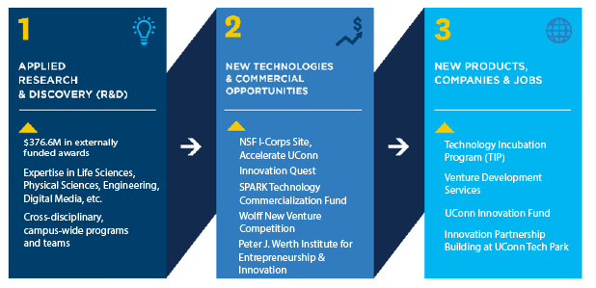
UConn Research & Innovation:
Economic Driver for CT
University Initiated Pipeline for an Innovation Economy
UConn generates new discoveries that move through translational stages towards commercialization, investment, new companies, and new jobs for Connecticut
Notes:
updated10/21

Slide 24
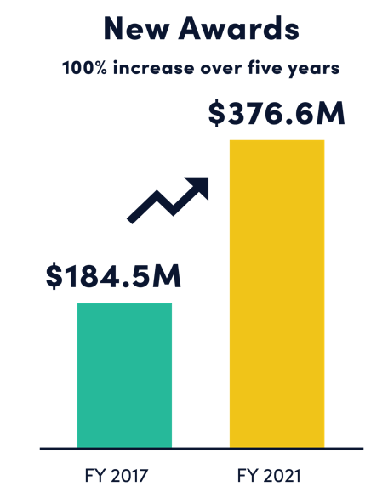
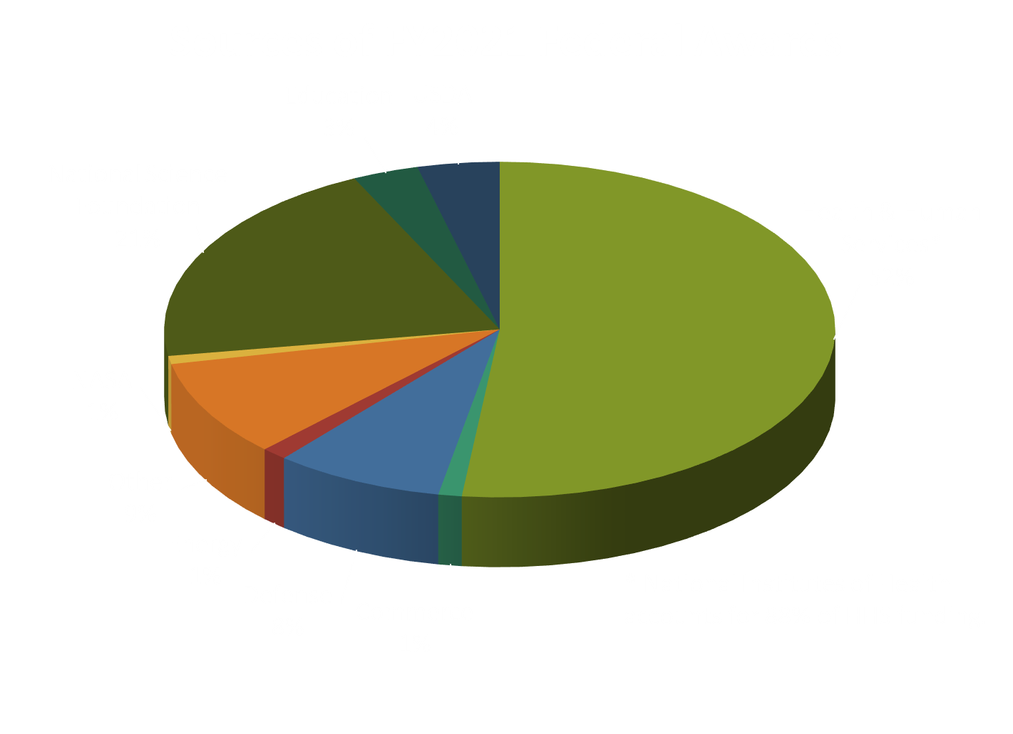
UConn Research & Innovation:
Record High Research Awards in FY21
Federal and industry grants fund groundbreaking basic and applied research to fuel new discoveries and the development of promising technologies

Slide 25
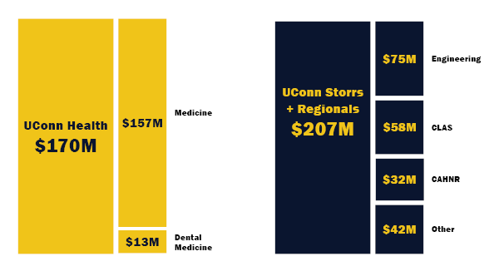
UConn Research & Innovation:
New Awards by Campus

Slide 26
UConn Research & Innovation:
Commercialization & Company Creation
FY21 Technology Commercialization
Activity:
91 invention disclosures received
102 U.S. patent applications filed
28 patents issued
10 licenses & options executed
$1.2M licensing revenue
5 startups formed by faculty, 2 student startups supported by UConn Research
Recent Success and Rankings:
TIP was the 2021 winner International Business Innovation Association (InBIA) Randall M. Whaley Award
141 companies have participated since 2003 with $956 million raised
Support IP Development
New Venture Development
Incubate Startups
Research & Innovation success leads to technology commercialization,
creates new companies, new jobs, and positions Connecticut for economic growth
Notes:
Updated 10/21

Slide 27
UConn Research & Innovation:
Technology Incubation Program (TIP)
Moving technology from the lab to the market at UConn and UConn Health
 | TIP UConn and UConn Health Total FY21 | TIP UConn Health Total FY21 | TIP Stamford Total FY21 | TIP Storrs Total FY21
Raised in debt & equity funding | $57M | $53M | $3M | $227k
Raised in revenue from sales and grants | $14M | $10M | $2M | $2M
Companies located at the incubator | 58 | 36 | 11 | 11
Full-time (FT) and part-time (PT) Jobs | 204 (FT) 80 (PT) | 172 (FT) 49 (PT) | 14 (FT) 7 (PT) | 18 (FT) 24 (PT)
Incubator space occupied | 94% | 93% | NA | 97%
Taxes paid | $3,384,920 | $3,179,893 | $29,657 | $175,370
Notes:
Updated 10/21

Slide 28
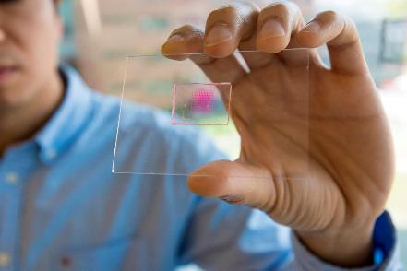
UConn Research & Innovation:
Commercialization & Company Creation
What Do We Need to Accelerate Growth?
To build on current strengths, gain momentum and see faster returns, we need:
Dollars
Proof of concept funds to more quickly and substantially transform ideas into products
People
More researchers to grow UConn’s Research & Innovation pipeline and encourage student inventors and entrepreneurs
More venture development expertise to generate innovation activities, venture development, etc.
Continued investments to grow UConn’s innovation pipeline drive the growth of CT’s economy
Notes:
Update after the board gets tech transfer plan
No changes 10/21

Slide 29

UConn Research & Innovation:
Support & Grow Existing Industries
Types of University-Industry Partnerships:
Industry Contracts
Joint Research Grants
Student Internships
Scientific/Engineering Support
Clinical Trials
Technology Development
Shared Equipment
Proof of Concept Resources (money & facilities)
Partner and Startup Co-location (e.g. Innovation Partnership Building)
When UConn’s world-class researchers collaborate with industry, economic growth and competitiveness of CT is increased
Notes:
No changes 10/21

Slide 30






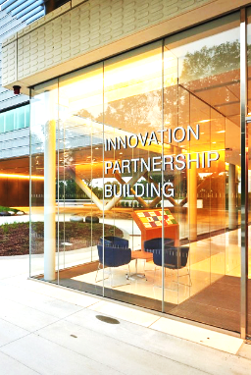
UConn Research & Innovation:
Support & Grow Existing Industries
Innovation Partnership Building (IPB) at UConn Tech Park
Energy
Cyber
Materials
Manufacturing
Data Science
AI/Robotics
PARTNER WITH INDUSTRY
Innovations that will define the future of their businesses
Develop joint research grants
Attract large corporations and SMEs in supply chain
Shared equipment
Advanced modeling
Faculty expertise across disciplines
PARTNERSHIP OPPORTUNITIES
Industry contracts
Joint research grants
Internships for students
Scientific/engineering support
Proof of Concept space
The IPB connects small and large businesses with faculty experts in state-of-the-art labs to fuel scientific breakthroughs, advance innovative products, and provide economic benefit to the State of Connecticut
Notes:
No changes 10/21

Slide 31













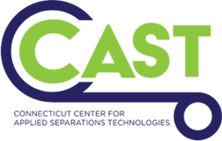
UConn Tech Park – Innovation Partnership Building
UConn Tech Park serves as the main gateway for industry engagement with the University, building collaborative partnerships with industry and federal government to drive economic competitiveness across Connecticut’s core sectors
$120M+
Current federal and industry partnerships funding
$7.5M
$25M
$2.2M
$7.5M
Pratt & Whitney Additive Manufacturing Center (PW AMC)
Collins Aerospace Center for Advanced Materials
Comcast Center of Excellence for Security Innovation (CSI)
UConn - Thermo Fisher Scientific Center for Advanced Microscopy and Materials Analysis (CAMMA)
$17.5M
$18.1M
$19.9M
$10M
Eversource Energy Center
Daedalus Air Force Advanced Manufacturing Initiative
National Institute for Undersea Vehicle Technology
UTC Institute for Advanced Systems Engineering (UTC-IASE)
$9M
$3.2M
$12.2M
Reverse Engineering Fabrication Inspection & Non-destructive Evaluation (REFINE)
Synchrony Financial Center of Excellence in Cybersecurity
Connecticut Center for Applied Separations Technologies (CCAST)
Notes:
Updated 10/21

Slide 32
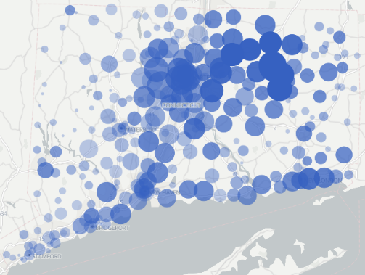
Grant Trails
Grant Trails (https://granttrails.uconn.edu/CT) interactively shows you where research grants awarded to UConn faculty are spent throughout our state
Federal, state, and corporate grants support researchers at an institution. But their contribution to local economies is often overlooked. Grant dollars are used to pay for equipment, reagents, consumables, salaries, etc. throughout the state that are required to carry out research at UConn
UConn
Note: Grant Trails is an open source project, conceived and built at UConn (with talented undergraduates), and available for any institution wishing to visualize their grant expenditures geographically
Notes:
-no changes 10/21

Slide 33
COVID-19 Research at UConn/UConn Health
From the development of emergency ventilators to diagnostics and behavioral health interventions, researchers at UConn and UConn Health are producing invaluable research to address the COVID-19 pandemic
Storrs/Regionals
Economic Effects of COVID-19 on the Dairy Industry, College of Agriculture, Health & Natural Resources
Compact Field Portable Biophotonics Instrument for Real-Time Automated Analysis and Identification of Blood Cells Impacted by COVID-19
An integrated surveillance program for improved detection, containment and mitigation of COVID-19
Effects of COVID-19 on Domestic Violence
Single-Administration Microneedle Skin Patch for Novel Vaccination Technology
UConn Health
UConn, Local Company Commercialize Custom-Fit COVID-19 Mask
Rapid and Ultrasensitive SARS-CoV-2 Detection in Wastewater by Smartphone
Nuclear Magnetic Resonance Facility To Study SARS-CoV-2 Protein, Protein Domains
Notes:
No changes 10/21

Slide 34
UConn
Next Generation Connecticut

Slide 35
Next Generation Connecticut Overview
  UConn continues the transformation of modernizing, rehabilitating and expanding the physical plant of the University through the NextGenCT initiative
Approved in 2013, NextGenCT is an ambitious plan (FY15-FY27) to improve UConn’s STEM capabilities. Specifically, the initiative is designed to:
  Build STEM facilities including classrooms, equipment and laboratories
  Upgrade aging infrastructure to accommodate faculty and students
  Hire new faculty & enroll more undergraduates primarily in STEM areas (dependent on new State operating funds)
  Increase research and innovation

Slide 36
NextGenCT Progress - Student Growth
Since FY13, total undergraduate enrollment has increased by 1,536 students or 7% despite NextGenCT operating fund shortages – growth at Storrs is more than the planned amount
Undergraduate STEM enrollment increased by 35% since FY13
(all campuses)
Engineering enrollment increased 64% to 3,478 (all campuses)
*Note: Original NGC planed enrollment by FY27 was 28,881
Notes:
OIR – DONE 11-4-2021

Slide 37
NextGenCT: CT’s Tech Talent Pipeline
  UConn is the primary engine that feeds the tech talent pipeline in the State to support innovation and economic growth
 | Fall 2021 Actual | Change from FY13
First Year Applications: Total | 38,929 | 7,566 | +24%
Storrs Undergraduates: STEM | 10,791 | 2,665 | +33%
Storrs Undergraduates: Total | 18,917 | 1,389 | +8%
Undergraduates: Total | 24,371 | 2,070 | +9%
Graduate: Total | 6,928 | 315 | +5%
Bachelor’s Degrees: STEM (FY21) | 3,176 | 789 | +33%
Bachelor’s Degrees: Total (FY21) | 5,623 | 501 | +10%
Masters & Doctoral Degrees: STEM (FY21) | 656 | 64 | +11%
Masters & Doctoral Degrees: Total (FY21) | 2,294 | 427 | +23%
Notes:
OIR – DONE 11-4-2021

Slide 38
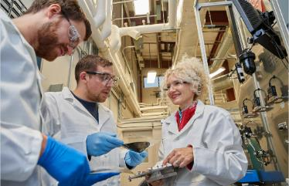
NextGenCT and Engineering Industry
The Connecticut Department of Labor expects a 17% overall increase in engineering employment between 2016 and 2026
Why do we need more engineering students?
Engineers are needed within many sectors of the Connecticut economy including aerospace, naval, healthcare and insurance
Connecticut is home to Electric Boat, Sikorsky, Pratt and Whitney and their ecosystem of more than 1,000 suppliers throughout the state
  Pratt and Whitney is expected to double their current production, requiring an additional 8,000 new employees
  Sikorsky is expected to double in size
  Electric Boat will hire 18,000 new workers
UConn produces over 53% of all the engineering graduates in Connecticut
A recent survey shows 91% of UConn Engineering graduates are either employed or continuing their education within 6 months of their graduation
Notes:
OIR 1st sentence
Rest is Kylene Perras (Engineering) 10/21-updated

Slide 39
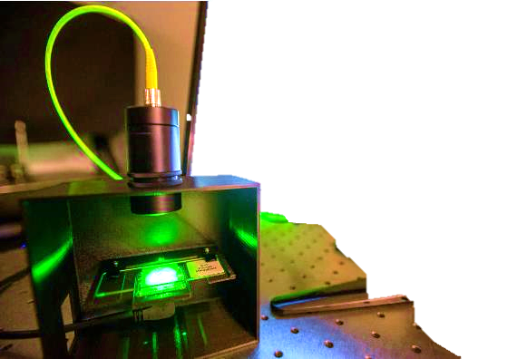
NextGenCT: STEM Success
  UConn is a major supplier of talent in the Connecticut workforce
Examples
Aerospace & Naval
Pratt & Whitney, a Raytheon Technologies Company (RTX) ~1200
General Dynamics Electric Boat ~800
Collins Aerospace, a Raytheon Company ~ 520
Insurance
Travelers ~950
The Hartford~900
CVS Health Aetna ~880
Connecticut consistently ranks in the highest category nationally for education of its workforce
Notes:
Partly Kylene Peras and CCD on the number of companies with employed graduates – 10/21 updated

Slide 40
UConn
Operating Budget

Slide 41
Overview
The FY22 budget is forecasted to be balanced, however projected out-year deficits reveal continued fiscal challenges
While the COVID threat will subside, unfunded legacy fringe costs remain, and collective bargaining increases (CBI) are unknown or unsettled.
Tuition level already at a competitive peak, meaning we may lose students beyond certain levels.
Options remaining to reduce costs/spending will erode academic excellence or diminish student services.
Notes:
Updated 10/21

Slide 42
Budget Framework: FY22
This is how UConn will pay for its $1.6 billion in FY22 costs
Source of funds |  | FY22 Amount | Share of budget | Use of funds
State | Block grant | $208M | 13% | Salaries for 47% of employees
 | Fringe reimbursement | $201M | 13% | Fringe for 47% of employees
Students | Tuition | $473M | 29% | Instructional costs
 | Fees | $298M | 18% | Housing, dining, academic support, student service costs
University | Grants, contracts, gifts | $307M | 19% | Research and public service; includes federal COVID relief funding
 | Sales, auxiliary, other | $122M | 8% | Commercial activities, programmatic maintenance, etc.
Notes:
Updated 10/21

Slide 43
FY22 Revenue by Category
The University relies more on tuition than any other revenue source at almost 30%; State support in the form of the block grant is only 12.9% of total revenues, and when combined with the State fringe reimbursement, only accounts for 26% from the State
FY22 Budget
Note: Use of decimals may result in rounding differences
Auxiliary revenue includes student fees such as room/board/parking/health services, as well as revenue from Athletics, Jorgensen and other student-related activities
Notes:
Updated 10/21

Slide 44
State Budget FY23
UConn is grateful for the significant support provided in the Governor’s budget proposal. We will continue to request funding for FY23 of $58.5M for salary increases, fringe and legacy costs.
*Note about CBI funding proposal:
FY22: Non-block grant - $25.3M is being allocated one-time through a deficiency bill, fully covering non-block grant CBI's (salary & fringe). Block grant - CBI's will be fully funded through the RSA allocation.
FY23: Non-block grant - Due to the one-time funding in FY22 not carrying forward, the non-block grant CBI funding of $20M is short by $12.5M (salary & fringe). Block grant - CBI's will be fully funded through the RSA allocation in the Governor's budget.
Notes:
Updated 10/21

Slide 45
Budget Trends: State Block Grant - Allotment
  The State Block Grant is only used for salaries of University employees and only covers 47% of our employees; since FY10, the State Block Grant has averaged ~$212M per year
$32M cut since FY16
($70M when adding in lost fringe reimbursement)
Notes:
Updated 10/21

Slide 46
Cuts in State Support
  Since FY12, UConn has sustained $90.2M in reductions* after each annual State budget was approved
*Reductions = lapses, rescissions, lost fringe reimbursements, fund sweeps and deficit mitigation
Notes:
Updated 10/21

Slide 47
Budget Trends: Tuition Replaces Lost State Support
As total State support declines, UConn must rely more on tuition revenues to cover more of its expenses, which shifts the cost burden onto students and their families
$64.1 M
$31.1 M
Notes:
updated 10/21

Slide 48
FY22 Expense by Category
Salary and fringe benefit costs, primarily due to the state’s unfunded legacy costs, are growing at a significant pace and account for nearly 55% of the University’s operating budget
FY22 Budget
Note: Use of decimals may result in rounding differences
Other Expenses includes dining services food and labor, lab supplies, janitorial services, facilities contracts, dues and memberships, travel, etc.
Notes:
Updated 10/21

Slide 49
Rising Fringe Costs
As fringe costs rise, and the State covers a smaller share of the expenses, UConn pays more for fringe expenses and less for student service expenses
UConn’s Share ($156.6M =
46%)
UConn’s Share ($61.8M = 39%)
Fringe rates are determined by the State Comptroller's Office
Notes:
Updated 10/21 – except UCH fringe

Slide 50
Budget Risks
Future outstanding budget risks include:
Collective Bargaining Negotiation – Unsettled Contracts
  Potential cost = $7.2M per 1% CBI
Unfunded Legacy Fringe Costs
  UConn will pay ~$38.7M in unfunded legacy fringe costs in FY23 and it will continue to grow in the out-years. The full cost is $44.8M in FY23 however the State has allocated $6.1M in carryforward fund support.
27th Payroll in FY23
  Lack of additional state funding will cost us $15M
Notes:
Updated 10/21

Slide 51
UConn Budget Impacts Excellence
Threats to UConn’s budget will impact student success, affordability, and national reputation
With strong State support, UConn climbed its way to become a top 20 public research university – reaching as high as #18 in US News in 2018 out of 190 major public research universities nationwide
While UConn is currently ranked as #23 in US News, continued reductions in State support will have negative impacts on UConn students and the State’s economy
  Students pay more tuition & fees to offset declining State support
  Class sizes increase while class offerings decrease, resulting in diminished educational quality and longer times to graduation
  Student services will be limited, including fewer academic advisors, mental health counseling, and other support services
  Competition for and retention rates of best faculty decline, leading to fewer research grants and industry partnerships
Notes:
11-5-2021 Rankings confirmed and updated. Note: UConn is now top 25 public national school.
First bullet point – #18 in the 2018 US News Best Colleges Edition.
Second bullet point – ranking is current, 2022 edition.

Slide 52
UConn
Capital Budget

Slide 53
Capital Program Challenges
Instability in economy is contributing to workforce, supply chain and funding uncertainty
COVID has created capital program risks and challenges that could result in project delays
  Potential for workforce limitations, interruptions or unavailability – job site safety is highest priority
  Unknown impact to supply chain for select materials – timing and cost
Future State funding is not guaranteed
Project delays result in increased costs and reduced project scopes; current construction cost annual escalation estimated @ 0.5% per month or 6% per year
Notes:
Updated 10/21

Slide 54
Capital Budget Plan
The long-term capital budget plan is continuously reviewed to ensure funding for our highest priorities
Notes:
Updated 10/21

Slide 55
UCONN 2000 State General Obligation Bonds
Bonding Schedule ($M) |  | Current Statute | Status
Phase I | FY96-FY99 | $382.0 | Complete
Phase II | FY00-FY05 | 580.0
Phase III | FY05-FY19 | 2,384.4
Phase III | FY20-FY21 | 457.2 | Active
 | FY22 | 215.5
 | FY23 | 125.1
 | FY24 | 84.7
 | FY25 | 56.0
 | FY26 | 14.0
 | FY27 | 9.0
 | Total | $4,307.9
UCONN 2000 State supported GO bonds fund the majority of the capital budget
UCH has requested additional funds for Deferred Maintenance in FY23
Notes:
Updated 10/21

Slide 56
FY22 Capital Budget by Fund Source
61% of the capital budget is funding active construction projects, with the remaining 39% dedicated to planning and design
Academic & Research Facilities | $73.0 | STEM Science 1 Building
Infrastructure DM | 24.8 | Science Program Utilities
Other DM | 61.7 | Academic Renovations, Code Corrections, Other, Contingency
Equipment | 16.0 | Faculty start-up/research, IT network, Other
Residential Life | 15.0 | Housing Renovations
UCH DM | 25.0 | Critical deferred maintenance
UCONN 2000 State Bonds | $215.5
Other Funds | 56.0 | Faculty Innovators, Facilities Repairs, Academic Renovations, Hockey
Total Capital Budget | $271.5 | All capital projects costing $500K or more are submitted for Board action on a project-by-project basis
Notes:
Updated 10/21

Slide 57
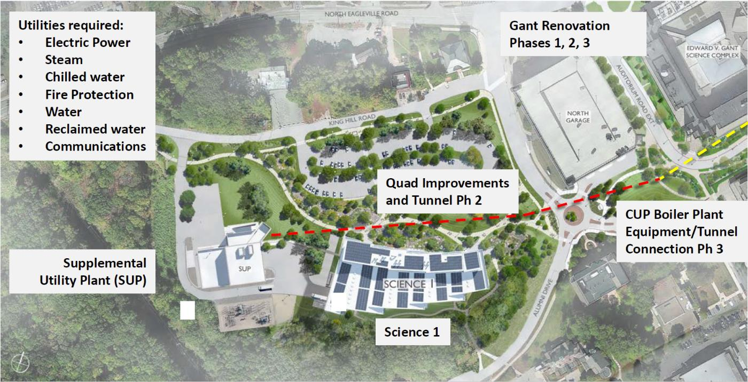
NW Science Quad – 5 Projects in Construction
As Gant Renovation Phase 2 is completed, Phase 3 design is underway along with construction of Science 1 and the enabling infrastructure projects
Notes:
Updated 10/21

Slide 58
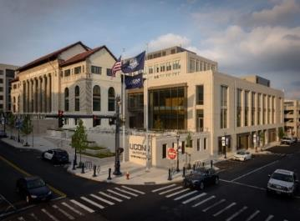
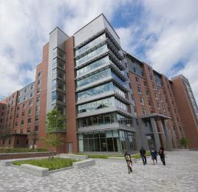
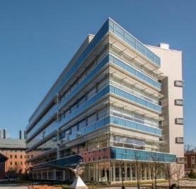
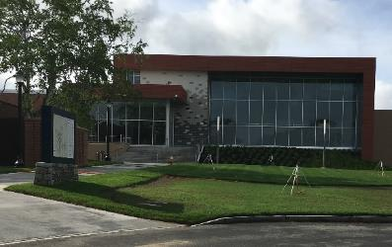
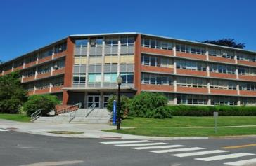


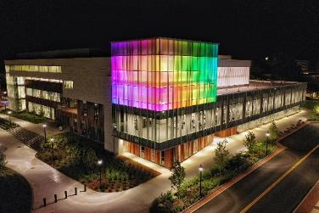
Major NextGenCT Buildings Opened
UConn Hartford Campus $139M
3 bldgs & 215,000 sqft Completed August 2017
Werth Residence Hall
$95.8M
212,000 sqft & 730 beds
Completed August 2016
Engineering & Science Building
~$92.5M
115,000 sqft
Completed October 2017
Fine Arts Production Facility
~$35.7M
30,000 sqft
Completed April 2020
Monteith Building Renovation
$23.7M
73,000 sqft
Completed August 2016
Gant Building Renovation Phase I -II
~$170M 200,000 sqft Completed August 2019, May 2021
Putnam Refectory Renovation
$18.7M
42,000 sqft
Completed August 2016
Student Recreation Center
~$100M
191,000 sqft
Completed August 2019
Notes:
Updated 10/21

Slide 59
Capital Program Summary
In spite of the negative COVID impacts, UConn continues to complete projects within the capital program
State bond funding currently in statute will support the academic and research priorities as well as other priority projects for Storrs and UCH
Construction began on the NW Quad Science projects which accomplishes the simultaneous goals of assisting in the State’s economic recovery from the COVID crisis, as the construction value of these projects supports the creation and/or preservation of thousands of jobs, as well as working towards the University’s goal of doubling research
While future year State bond funding is not guaranteed, UConn continues to work with the State to communicate project funding requirements
Notes:
Updated 10/21

Slide 60
Appendix

Slide 61
State Funds Flow and Legacy Costs
State
$117.0M is returned to the State to fund a portion of the State’s legacy pension and health liabilities.
$408.5M
$208.2M
$83.3M
$117.0M
Salaries /
Block Grant
Fringe -
Non-Legacy Costs
Fringe -
Legacy Costs
The total legacy cost to UConn is estimated ~$160.5M and the State covers $117.0M which means UConn is required to provide the remaining $43.5M from its self-generated revenues to cover a portion of the State legacy costs.
$43.5M
The total legacy cost to UConn is estimated ~$160.5M.
$160.5M
Note: Numbers represent FY22 budget
Notes:
Updated 10/21

Slide 62
State Support FY22
The final FY22 budget resulted in a $5M cut in the operating line.
Details FY22
In addition to the appropriation, UConn anticipates receiving $194M in fringe benefit reimbursements and adjustments for a total State support of $402.3M
Notes:
Updated 10/21

